Slide 1
Predicting Location of A New Asian Restaurant in Southwest Houston, TX Applied Data Science Capstone by IBM/Coursera
Deming Wang
Nov. 30th, 2020

Slide 2
1. Business Problem and Background
This project aims at analyzing restaurant distribution in West Houston and targets to stakeholders who are interested in opening a new Asian restaurant in Southwest Houston – Sugar Land and Missouri City.
Restaurants are one of the most popular business in West Houston. For example, Houston China Town and Katy Asian Town.
No similar food town in Southwest Houston (Sugar Land & Missouri City)
Demand for authentic Asian food is expected to remain strong in near future
Predict potential location for a new Asian restaurant in Southwest Houston area.

Slide 3
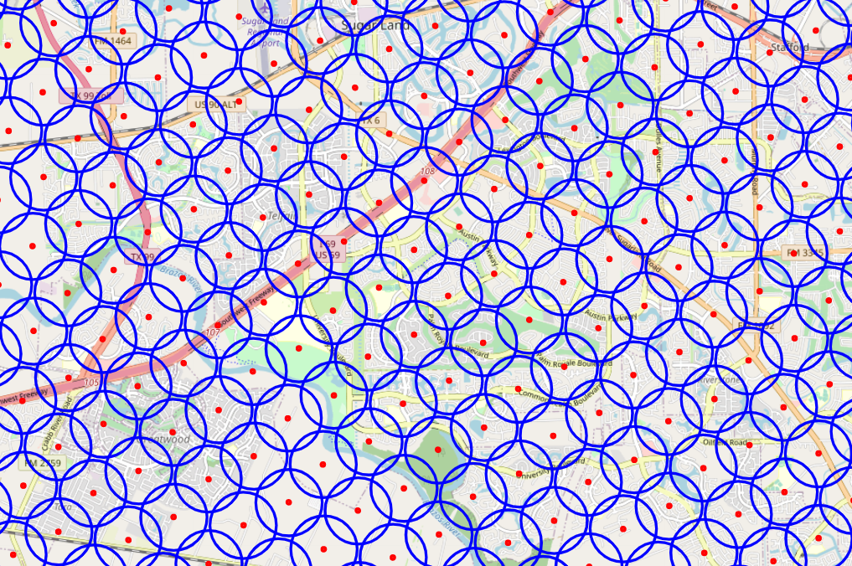
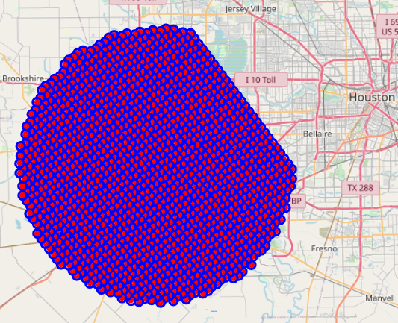
2. Data acquisition and cleaning
Generate 1534 points around center (Latitude: 29.6589382 Longitude: -95.7276974) in West Houston area
Use point locations to download all restaurants data using Foursquare API with category under “Food” (id: 4d4b7105d754a06374d81259)

Slide 4
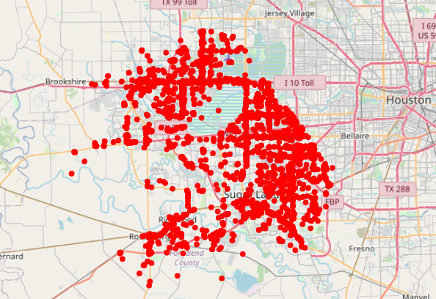
3702 restaurant data downloaded in West Houston

Slide 5
Combine restaurant categories
Original value | New value
[Empty] | Food
Sandwich Place Fried Chicken Joint Pizza Place Fish & Chips Shop Mac & Cheese Joint Breakfast Spot Donut Shop Food Truck Bakery Burger Joint Bistro Wings Joint Bagel Shop Snack Place Hot Dog Joint | Fast Food Restaurant
Irish Pub Gastropub | Pub
Creperie BBQ Joint Buffet Café Deli / Bodega Steakhouse Salad Place Food Court Soup Place | Cafe

Slide 6
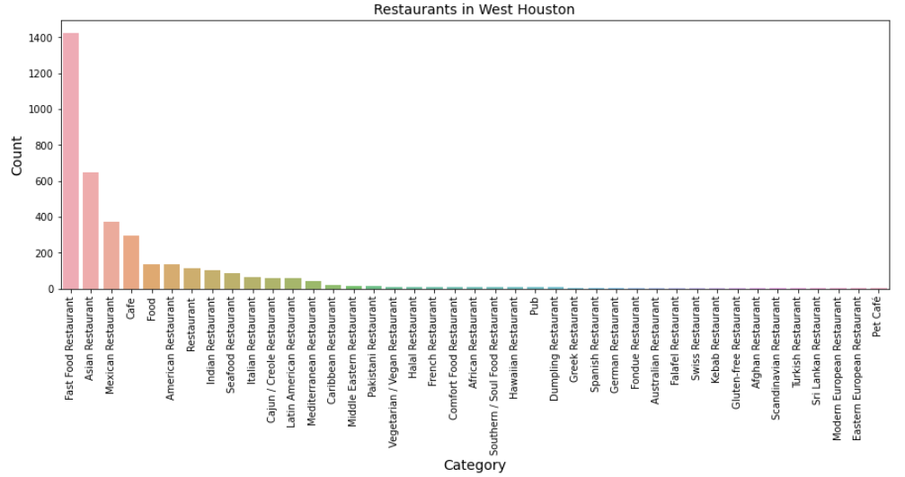
Restaurant distribution in West Houston

Slide 7
3. Methodology
Divide West Houston area to N x N grid and run K-Means to cluster restaurants based on category. Repeat this if no optimal K parameter found.
Assign area label to each restaurant
Identify optimal
K in model
Restaurants
Evaluate Model
Area
Run
Model
Predict
Devide West Houston area to
N x N Grid
Run K-Means clustering
Predict with
optimal K

Slide 8
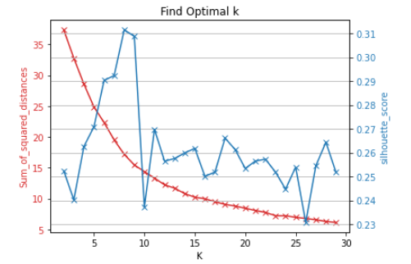
Quick test with 18 x 18 grid.
Result: no clear trend to identify K using elbow method
silhouette score (0.31) is too small to be acceptable.

Slide 9
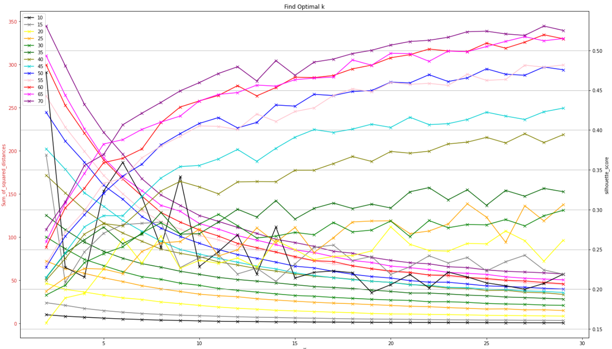
Uncertainty test: test N from 10 to 70
Run uncertainty test and select high silhouette score while keeping K small. N=65/K=20 seems acceptable

Slide 10
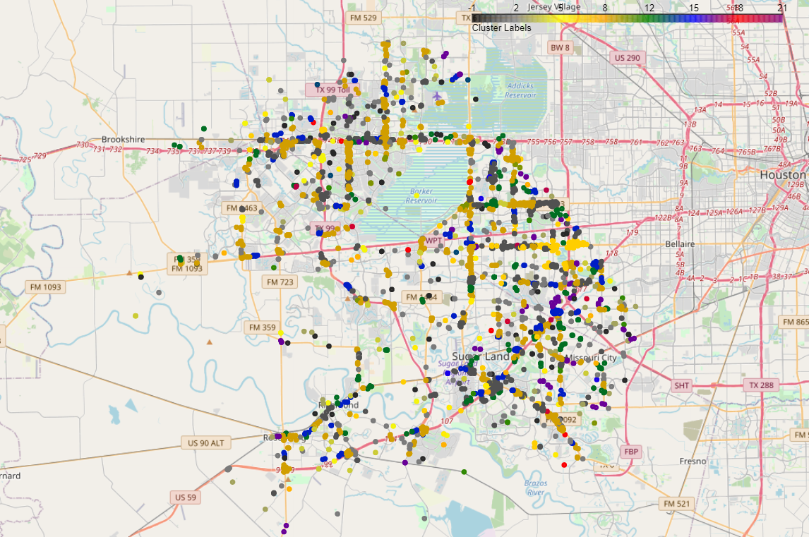
4. Clustering restaurants in 65x65 grid and 20 clusters

Slide 11
Top 5 Most Common Restaurants in each cluster
Cluster Labels | 1st Most Common Venue | 2nd Most Common Venue | 3rd Most Common Venue | 4th Most Common Venue | 5th Most Common Venue
0 | Cafe | Vegetarian / Vegan Restaurant | Eastern European Restaurant | Gluten-free Restaurant | German Restaurant
1 | Asian Restaurant | Fast Food Restaurant | Mexican Restaurant | Cafe | American Restaurant
2 | Fast Food Restaurant | Mexican Restaurant | Cafe | Pakistani Restaurant | American Restaurant
3 | Food | Vegetarian / Vegan Restaurant | Halal Restaurant | Gluten-free Restaurant | German Restaurant
4 | Mexican Restaurant | Italian Restaurant | Asian Restaurant | Food | Fast Food Restaurant
5 | American Restaurant | Fast Food Restaurant | Mexican Restaurant | Spanish Restaurant | Cafe
6 | Indian Restaurant | Fast Food Restaurant | Middle Eastern Restaurant | Asian Restaurant | Cajun / Creole Restaurant
7 | Asian Restaurant | Fast Food Restaurant | Cajun / Creole Restaurant | Food | Cafe
8 | Cajun / Creole Restaurant | Asian Restaurant | Fast Food Restaurant | Vegetarian / Vegan Restaurant | Eastern European Restaurant
9 | Fast Food Restaurant | Asian Restaurant | Mexican Restaurant | Cafe | American Restaurant
10 | Italian Restaurant | Restaurant | American Restaurant | Indian Restaurant | Fast Food Restaurant
11 | Restaurant | Indian Restaurant | American Restaurant | Vegetarian / Vegan Restaurant | Eastern European Restaurant
12 | Cafe | Fast Food Restaurant | Restaurant | Food | Caribbean Restaurant
13 | Caribbean Restaurant | Vegetarian / Vegan Restaurant | Eastern European Restaurant | Gluten-free Restaurant | German Restaurant

Slide 12
Top 5 Most Common Restaurants in clusters - continued
Cluster Labels | 1st Most Common Venue | 2nd Most Common Venue | 3rd Most Common Venue | 4th Most Common Venue | 5th Most Common Venue
14 | Mexican Restaurant | Fast Food Restaurant | Asian Restaurant | Cafe | American Restaurant
15 | Middle Eastern Restaurant | Vegetarian / Vegan Restaurant | Eastern European Restaurant | Gluten-free Restaurant | German Restaurant
16 | Food | Fast Food Restaurant | Mexican Restaurant | Seafood Restaurant | American Restaurant
17 | Latin American Restaurant | Fast Food Restaurant | Vegetarian / Vegan Restaurant | Eastern European Restaurant | Gluten-free Restaurant
18 | Seafood Restaurant | Vegetarian / Vegan Restaurant | Dumpling Restaurant | Gluten-free Restaurant | German Restaurant
19 | Mediterranean Restaurant | Afghan Restaurant | Eastern European Restaurant | Gluten-free Restaurant | German Restaurant
Asian restaurants are popular in west Houston area.
Cluster 1 and 7 with Asian restaurants as 1st most common venues
Cluster 8 and 9 with Asian restaurants as 2nd most common venues

Slide 13
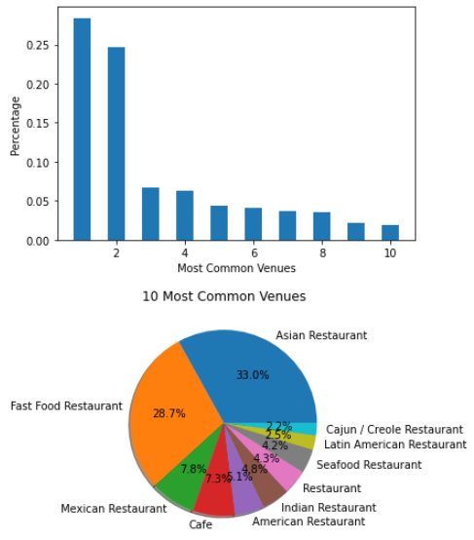
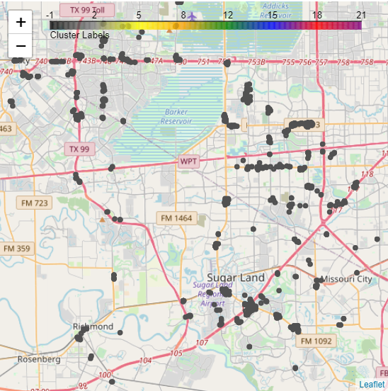
5. Discussion
Restaurants in cluster 1
Popular categories with 33% Asian restaurants and 28.7% Fast food restaurant in west Houston.
Most restaurants in Sugar Land/Missouri City area are located along highway 59 and 6.

Slide 14
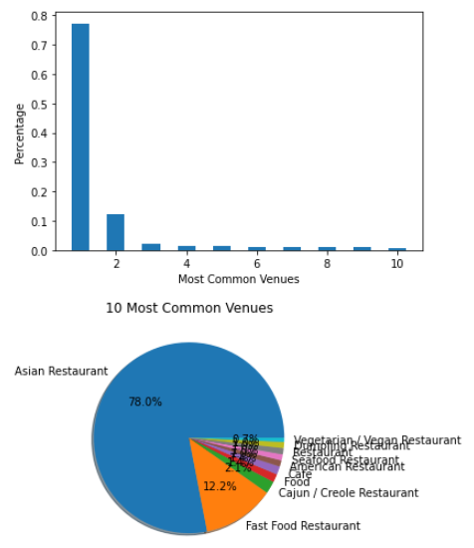
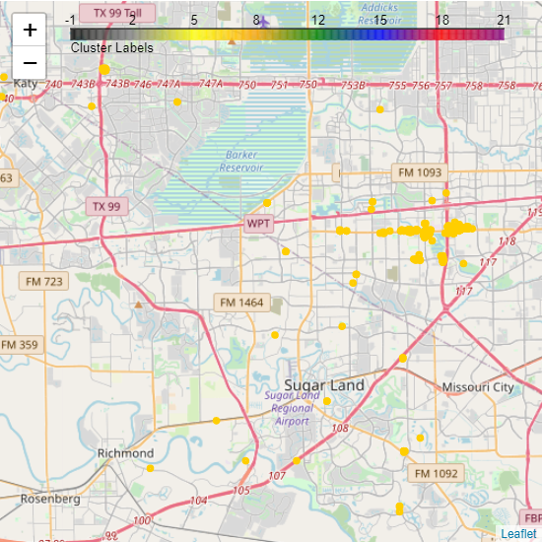
Restaurants in cluster 7
7, 78% restaurants are Asian restaurants: Hot spots for Asian food. Both Houston China town and Katy Asian town fall in this cluster
5 Asian restaurants in the plaza near Hight 6 and Austin Parkway in Sugar Land/Missouri City area. This is probably the best location for future Asian restaurant with the best traffic.

Slide 15
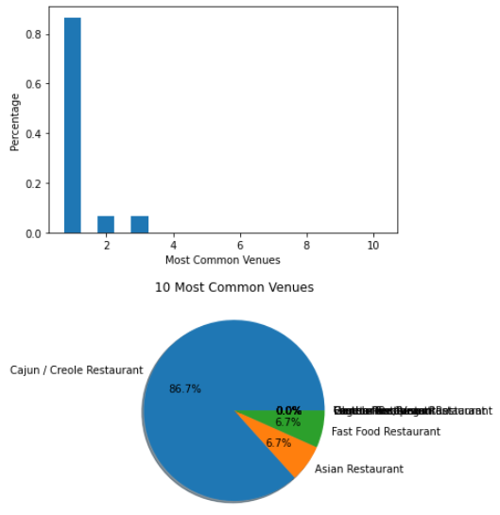
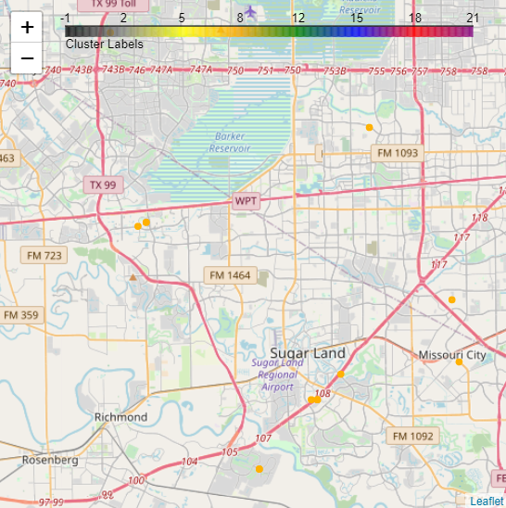
Restaurants in cluster 8
Only 6.7% Asian restaurants, and not many restaurants are observed from map.

Slide 16
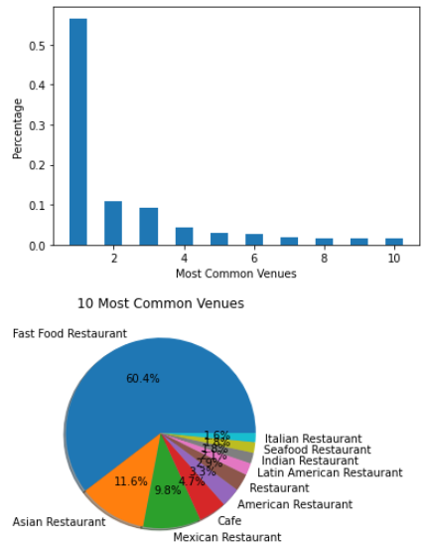
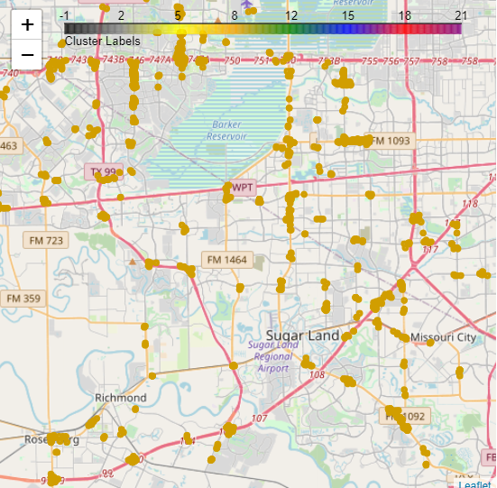
Restaurants in cluster 9
Popular in West Houston.
60.4% Fast food restaurants and 11.6% Asian restaurants
All these restaurants are mainly located along highway 6 in Sugar Land/Missouri area.

Slide 17
6. Conclusion
Considering the percentage/number of restaurants in each cluster, cluster 1,7,and 9 seem to be the best clusters for a new Asian restaurant in Sugar Land/Missouri City area.
Most of restaurants in cluster 1,7 and 9 are opened along highway 59 and 6.
Cluster 7 has the highest percentage of Asian restaurants and covers Houston China town, Katy Asian Town and a plaza with 5 Asian restaurants near Highway 6 and Austin Pkwy in Sugar Land. Therefore that plaza or a nearby location in Sugar Land might be a perfect place for opening a new Asian restaurant
Cluster 1 and 9 areas are also suitable for a new Asian restaurant business and more challenges will be expected with high percentage of fast-food restaurants.

Slide 18
References
Sugar Land, Wikipedia https://en.wikipedia.org/wiki/Sugar_Land,_Texas
Missouri City, Wikipedia https://en.wikipedia.org/wiki/Missouri_City,_Texas
Foursquare Venue Category Hierarchy https://developer.foursquare.com/docs/build-with-foursquare/categories/
Selecting the number of clusters with silhouette analysis on K-Means clustering https://scikit-learn.org/stable/auto_examples/cluster/plot_kmeans_silhouette_analysis.html

Slide 19
Github Link
Project implementation using python: https://github.com/wdmhouston/CapestoneProject_PredictingLocation/blob/main/CapestoneProject_PredictingLocation.ipynb
Project report: https://github.com/wdmhouston/CapestoneProject_PredictingLocation/blob/main/CapestoneProject_PredictingLocationon_Report.pdf
Project presentation: https://github.com/wdmhouston/CapestoneProject_PredictingLocation/blob/main/CapestoneProject_PredictingLocationon_Presentation.pdf

Slide 20
THANKS
For any questions?
wangdeming@gmail.com

